Slide 1
Messaging School Consolidation, Mergers & Closure with Clarity and Care
Data-informed messaging for leaders managing school consolidation, mergers and closure
Courtney Hughley, VP Communications, NACSA
Last Updated: August 2025

Slide 2
NACSA’s Mission
To advance and strengthen the ideas and practices of authorizing so students and communities - especially those who are historically under-resourced - thrive.​

Slide 3
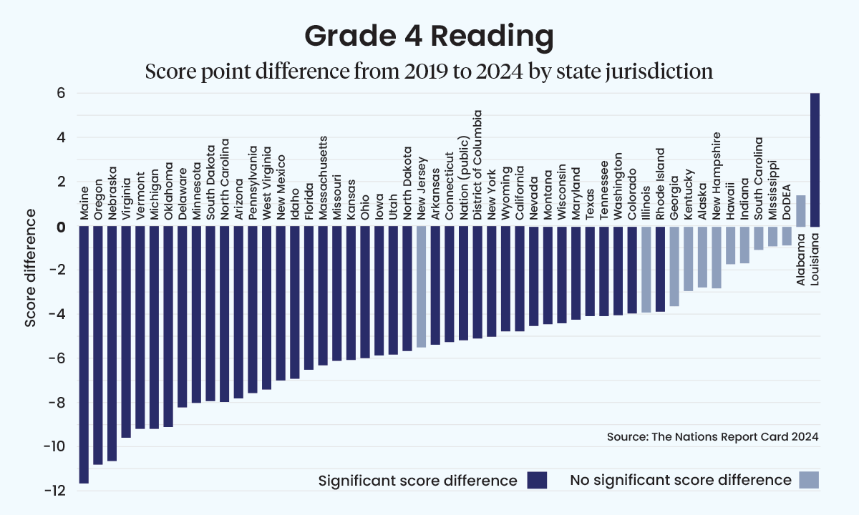
There’s a problem…
At present, far too many of our nation’s students are lagging academically and not getting what they need to support thriving futures. And, many schools are struggling financially and/or seeing declining enrollment.

Slide 4

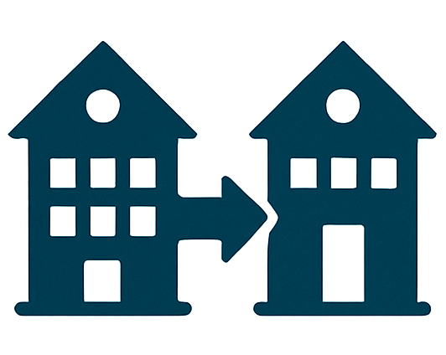

…and a solution
This means some schools need to consolidate, merge, and/or close.

Slide 5
But, talking about schools taking a different shape or going away is hard!

Slide 6


NACSA can help
The partnership of NACSA and Echelon makes us uniquely positioned to help address this challenge. NACSA and its staff have deep authorizing expertise and knowledge. Echelon and staff are in polling and optimizing messaging and identifying the target audience.
NACSA in partnership with Echelon Insights, now has evidence-based messaging that can equip decision makers—authorizers, advocates, board members, district leaders, philanthropic partners—to talk more compellingly about the need to close and/or consolidating schools.

Slide 7
Remember, a good message does not take the place of a good plan.

Slide 8
How?
The Research
Key Findings & Messaging
Recommendations
Other Notable Findings

Slide 9
The Research

Slide 10
Purpose
NACSA set out to learn:
  If there was a way to talk about closure that resonates with families and communities; and
  If the way we talk about closure impacts their support.
And we learned that it does!

Slide 11
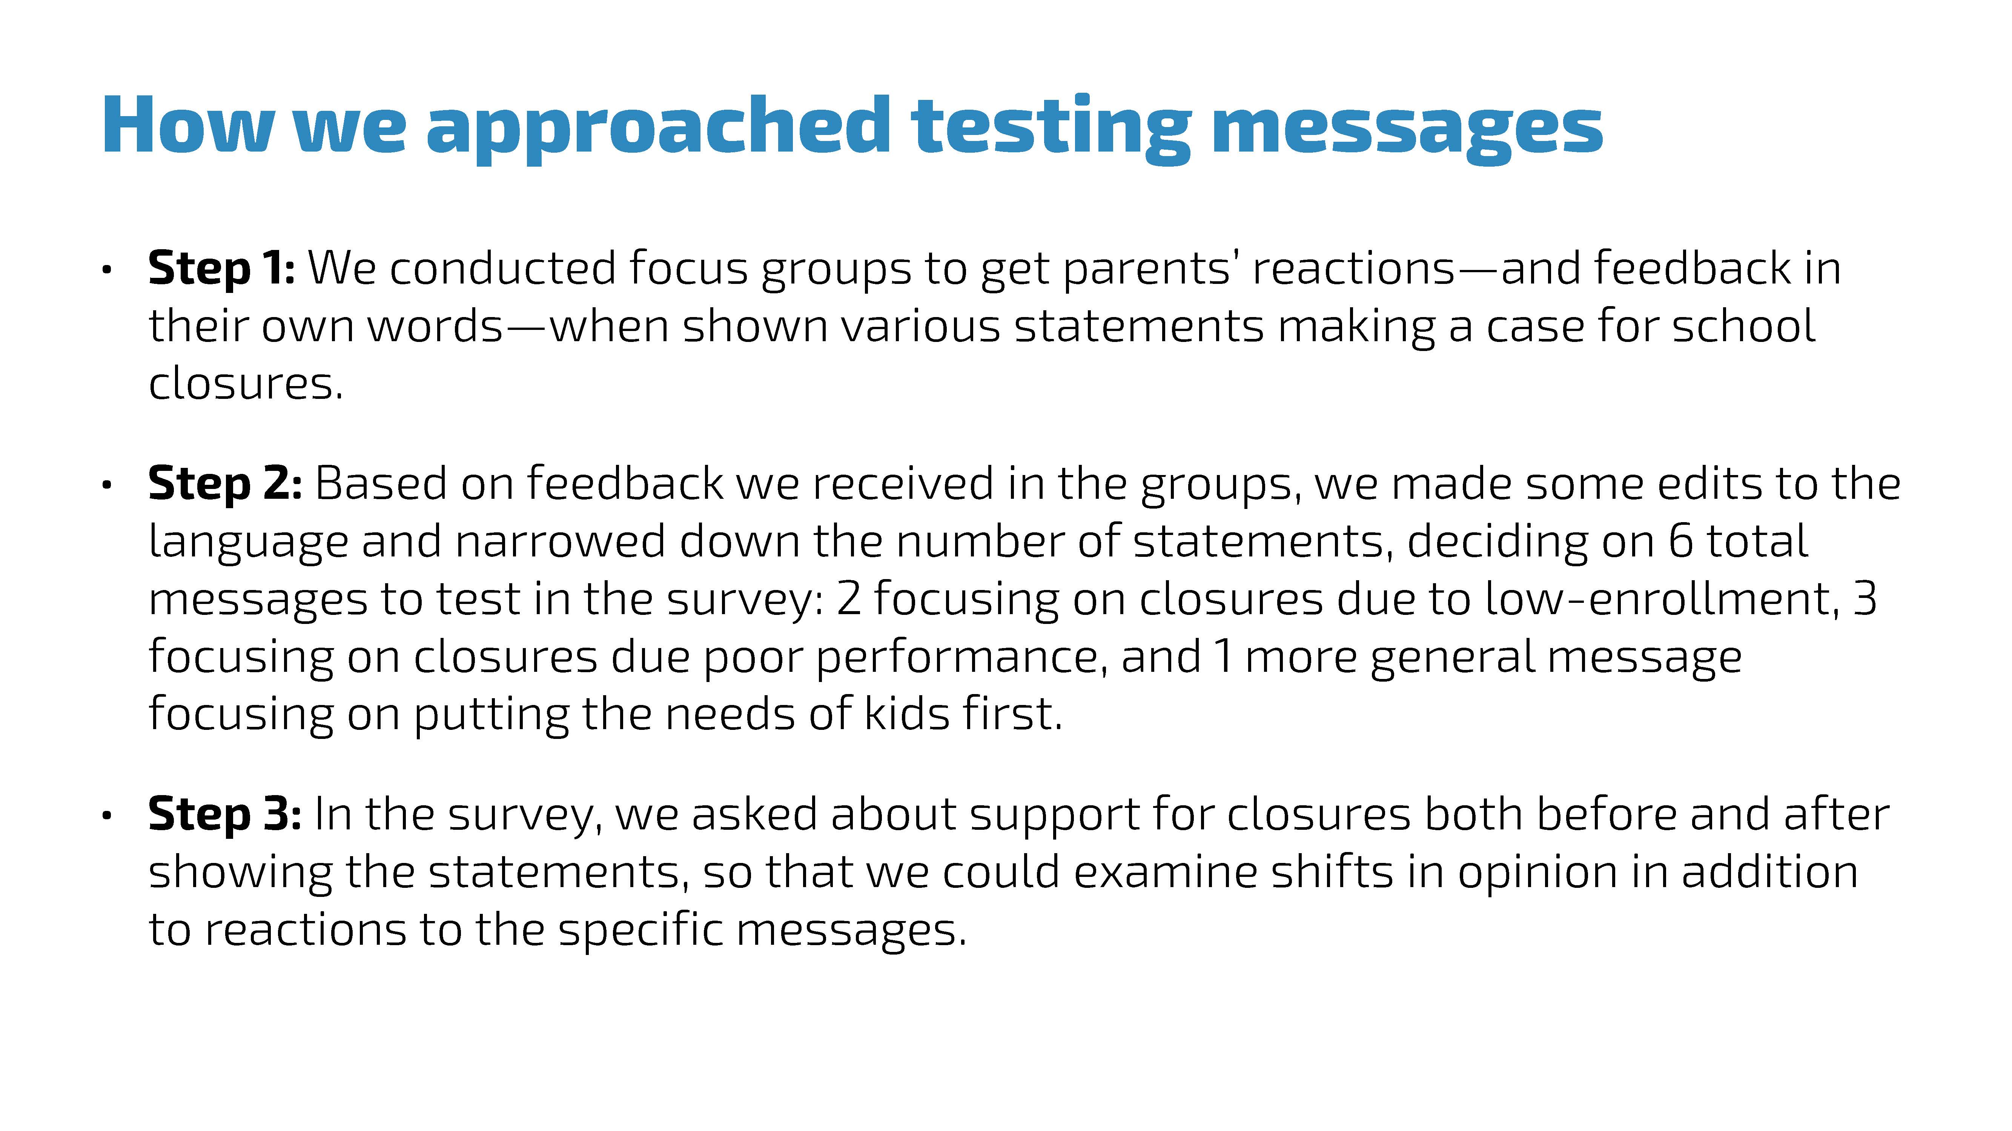

Slide 12
Key Learnings & Messaging

Slide 13
Low Performance Messages
We presented 3 messages on low academic performance in the focus groups.
1. Last Resort Decision
2. Accountability
3. Keeping Open Keeps Students Stuck

Slide 14
Low Performance Messages
1. Last Resort Decision:
No one wants to see a school close, and it should never be the first step in addressing challenges. School leaders should first provide support to try to help a school improve, but when every effort has been made and a school still isn’t meeting students’ needs, it’s worth it to make the tough decision to help kids get the education they deserve. School closures only happen when we’ve exhausted all other options and when it’s the best path forward for students.
2. Accountability:
Schools have a responsibility to provide students with a quality education. Charter schools often get flexibility to try new and innovative approaches, but sometimes those won’t always work out. When a school continuously underperforms and fails to improve, district and state leaders must take action to hold that school accountable and find a different school for those students, putting their education first.

Slide 15
Low Performance Messages
3. Keeping Open Keeps Students Stuck:
When a school has faced years of declining performance despite efforts to improve, keeping it open doesn’t fix the problem—it keeps students stuck in a system that isn’t working for them. Waiting for change that doesn’t seem likely to come wastes valuable years of a student’s learning potential. Our focus should always be on the students and what’s best for their future, and sometimes that means closing a school so they can get access to a better education elsewhere.

Slide 16
Low Performance Messages
So, we revised each message on low academic performance for the survey to include language that made it clear that it was calling for closure only after efforts to help the school had been made.

Slide 17
Low Performance Messages
Last Resort Decision
No one wants to see a school close, and it should never be the first step in addressing challenges. Leaders should first provide support to try to help a school with poor academic performance improve, but when every effort has been made and a school still isn’t meeting students’ needs, it’s worth making the tough decision to close a school to help kids get the education they deserve elsewhere.
Accountability
While leaders should try to help underperforming
schools improve, they must also hold schools accountable for providing a quality education. When a school continues to have poor academic performance for years despite efforts to help it improve, accountability means leaders should close the
school and find a better school for the students.
Students Stuck
When a school continues to have poor academic performance for years despite efforts to help it improve, keeping the
school open doesn’t fix the problem — it keeps students stuck in a system that isn’t
working for them, wasting valuable years of their learning potential.

Slide 18
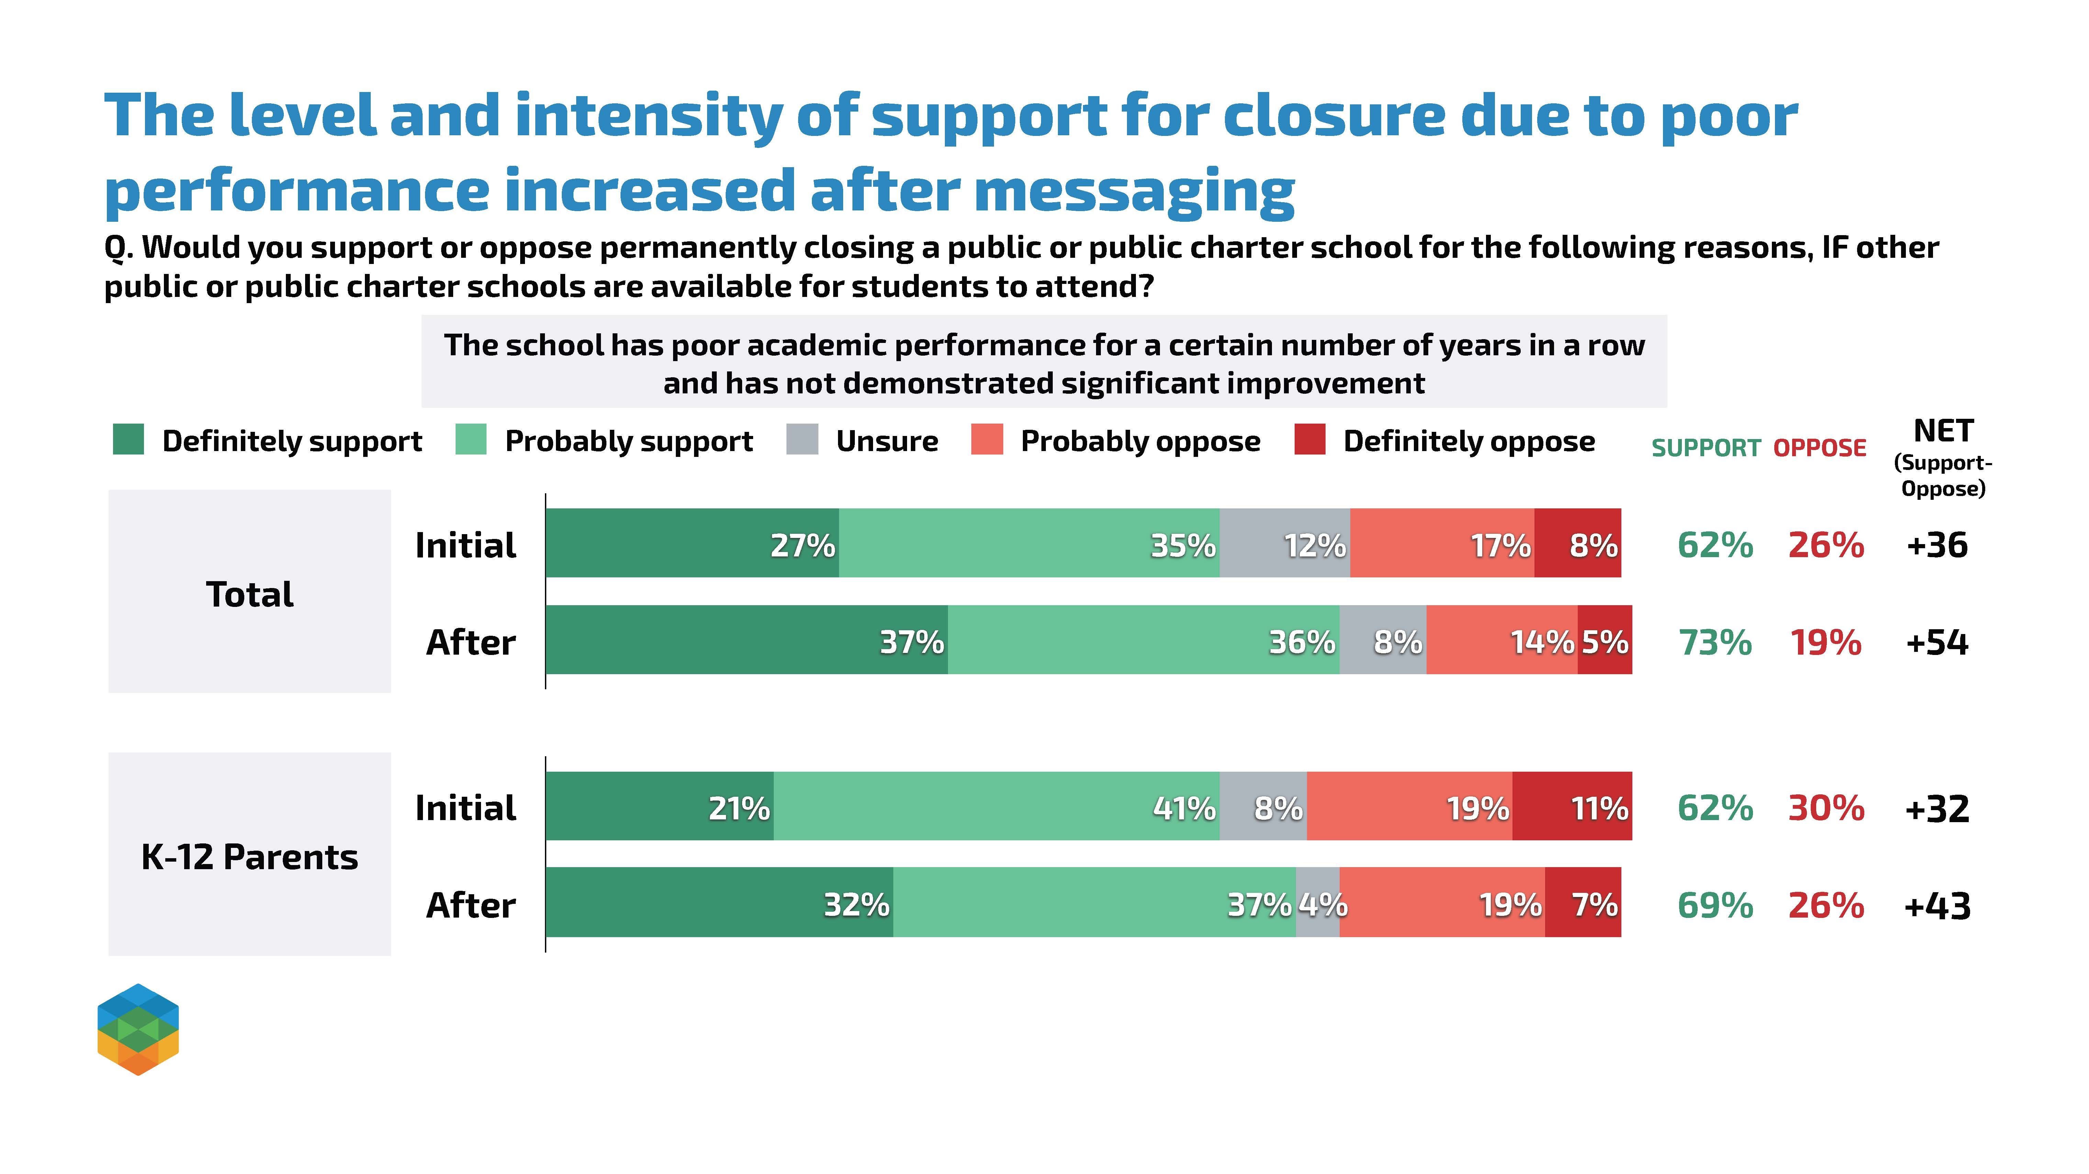

Slide 19
Low Enrollment Messages
We presented 4 messages on low enrollment in the focus groups.
Quality Programs
Taxpayer Dollars
Half-Full Classrooms
Teacher Shortages

Slide 20
Low Enrollment Messages
1. Quality Programs:
When a school has too few students, it can’t offer the same range of programs, extracurriculars, or advanced courses that students in fully enrolled schools have. Closing a school in this situation and moving students to a nearby school helps students have access to stronger programs, better resources, and a full academic experience.
2. Taxpayer Dollars:
Keeping a school open when it doesn’t have enough students to sustain it is not the best use of taxpayer dollars. Instead of spreading resources thin, we should focus on sending our students to schools that can fully support them with strong programs.

Slide 21
Low Enrollment Messages
3. Half-Full Classrooms:
When a school is only half full, it still requires the same upkeep—heating, electricity, and maintenance—without enough students to justify the cost. In these cases, closing the school and redirecting the per-pupil funds to fully enrolled schools ensures that funding is used effectively to support students and their education, rather than maintaining half-empty classrooms.
4. Teacher Shortages:
With teacher shortages across the country, it doesn’t make sense to have some educators teaching half-empty classrooms in under-enrolled schools. Consolidating schools can help put teachers where they’re needed most, with appropriately sized classes.

Slide 22
Low Enrollment Messages
So, we adapted two messages on low-enrollment for the survey. One focused on giving students access to more opportunities and the other on using funding effectively, referencing half-empty buildings instead of classrooms.

Slide 23
Low Enrollment Messages
Access to Opportunities
When a school has too few students, it can’t offer the same range of programs, extracurriculars, or advanced courses that students in fully-enrolled schools have. Closing a school with low enrollment and moving students to a nearby school gives them access to more opportunities.
Using Funding Effectively
When a school is only half full, it still requires the same
upkeep — heating, electricity, and maintenance — without
enough students to justify the cost. Closing schools with low
enrollment means funding can be used more effectively to
support students’ education at fully-enrolled schools, rather
than being used to maintain half-empty buildings.

Slide 24
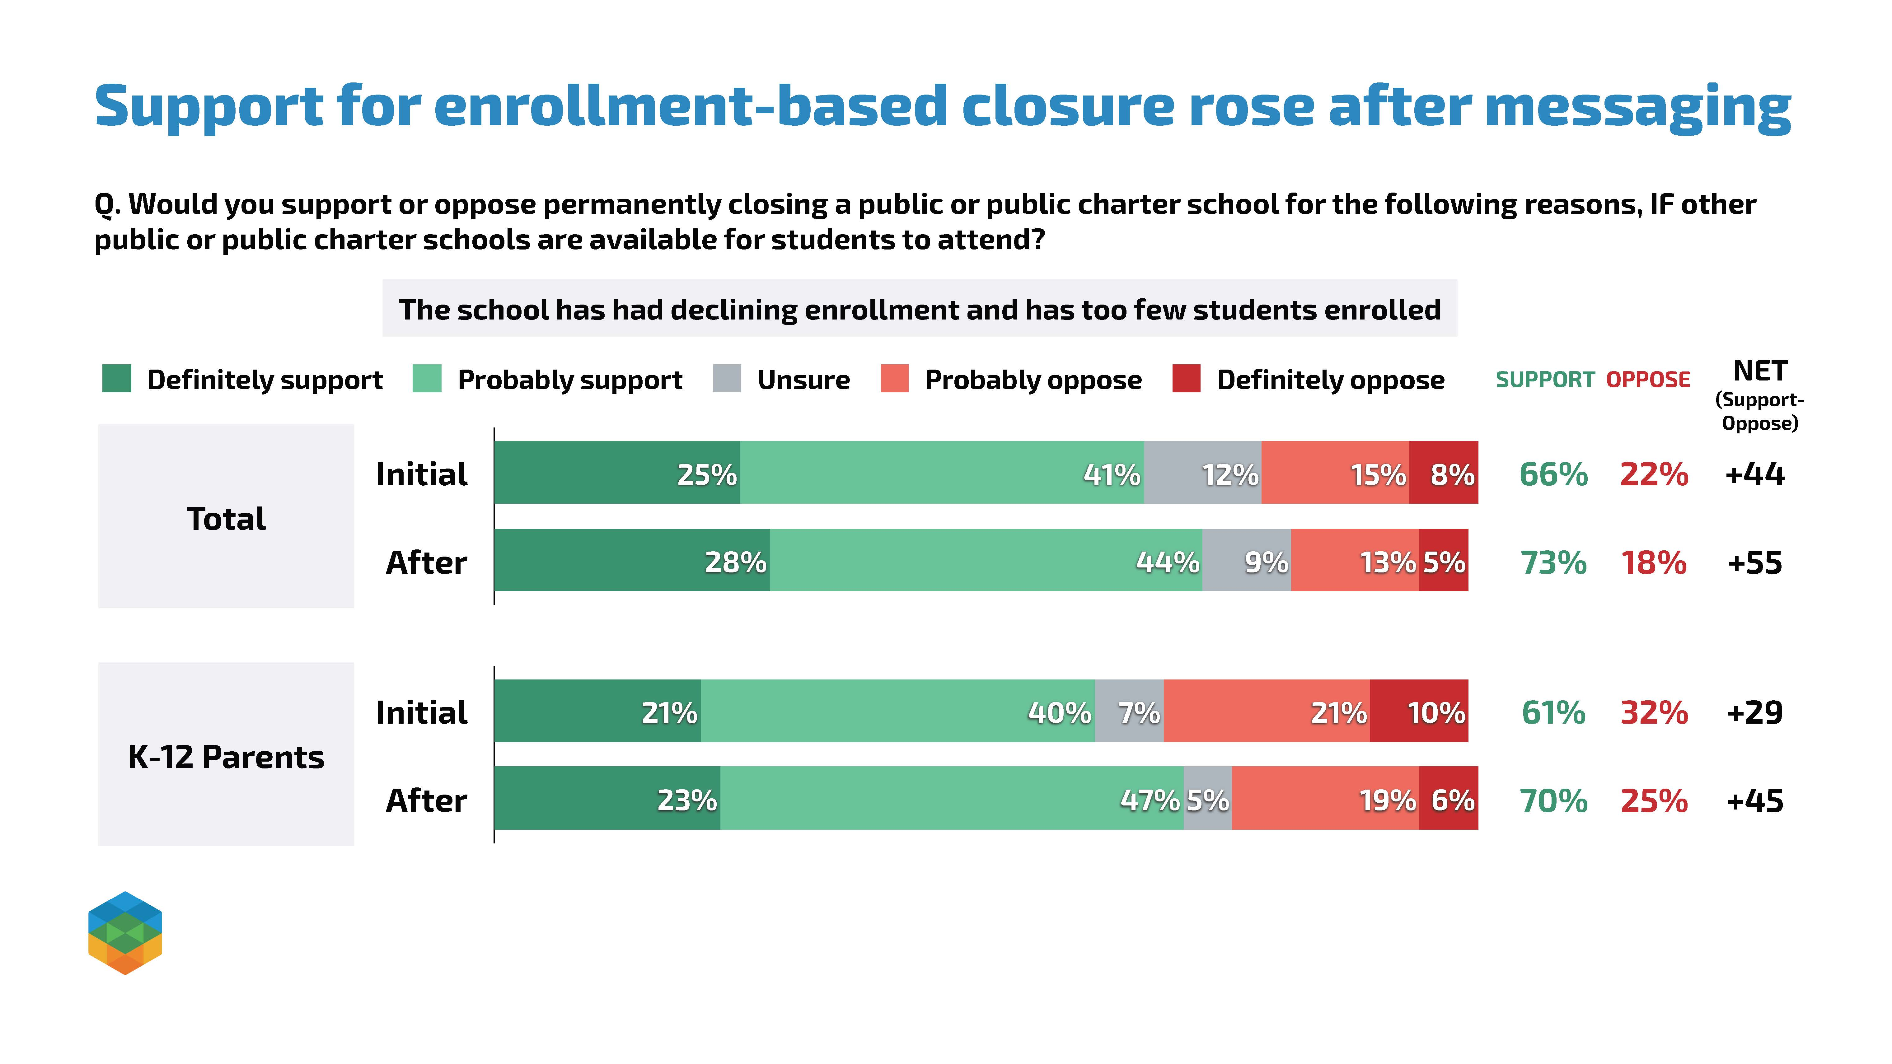

Slide 25
Community Impact Messages
We presented two messages related to community impact and staffing.
1. Emotional Ties
2. Kids Before Adults

Slide 26
Community Impact Messages
1. Emotional Ties
We know that schools are more than just buildings—they’re places where generations of families have learned, where communities have come together, and where lifelong memories have been made. That’s why closing a school is never an easy decision. But, ultimately, we need to prioritize what will provide kids with the best possible education. This isn’t about erasing the past, it’s about ensuring the next generation has a bright future.
2. Kids Before Adults
We know that when a school closes, it can be challenging for everyone involved. Teachers and staff may need to find new jobs, and communities may feel a loss. But in the end, it is our responsibility to put the needs of the kids first. While adults may need to adjust to new jobs or roles, students only get one chance at their education, meaning that sometimes leaders have to make the tough call to move students to a school where they have a better chance to thrive.

Slide 27
Community Impact Messages
So, we revised and simplified the message to ensure it was clearly making the case that we need to put the needs of kids first, even when it is challenging for adults in the school community.

Slide 28
Community Impact Messages
If closing a school will give students a better chance of getting a quality education elsewhere, it is the right thing to do, even if it is challenging for adults in the school community. We know it may be hard for teachers and staff to have to transition to new jobs, and for families and alumni to lose a school where they made memories, but ultimately, it is our responsibility to put the needs of the kids first.

Slide 29
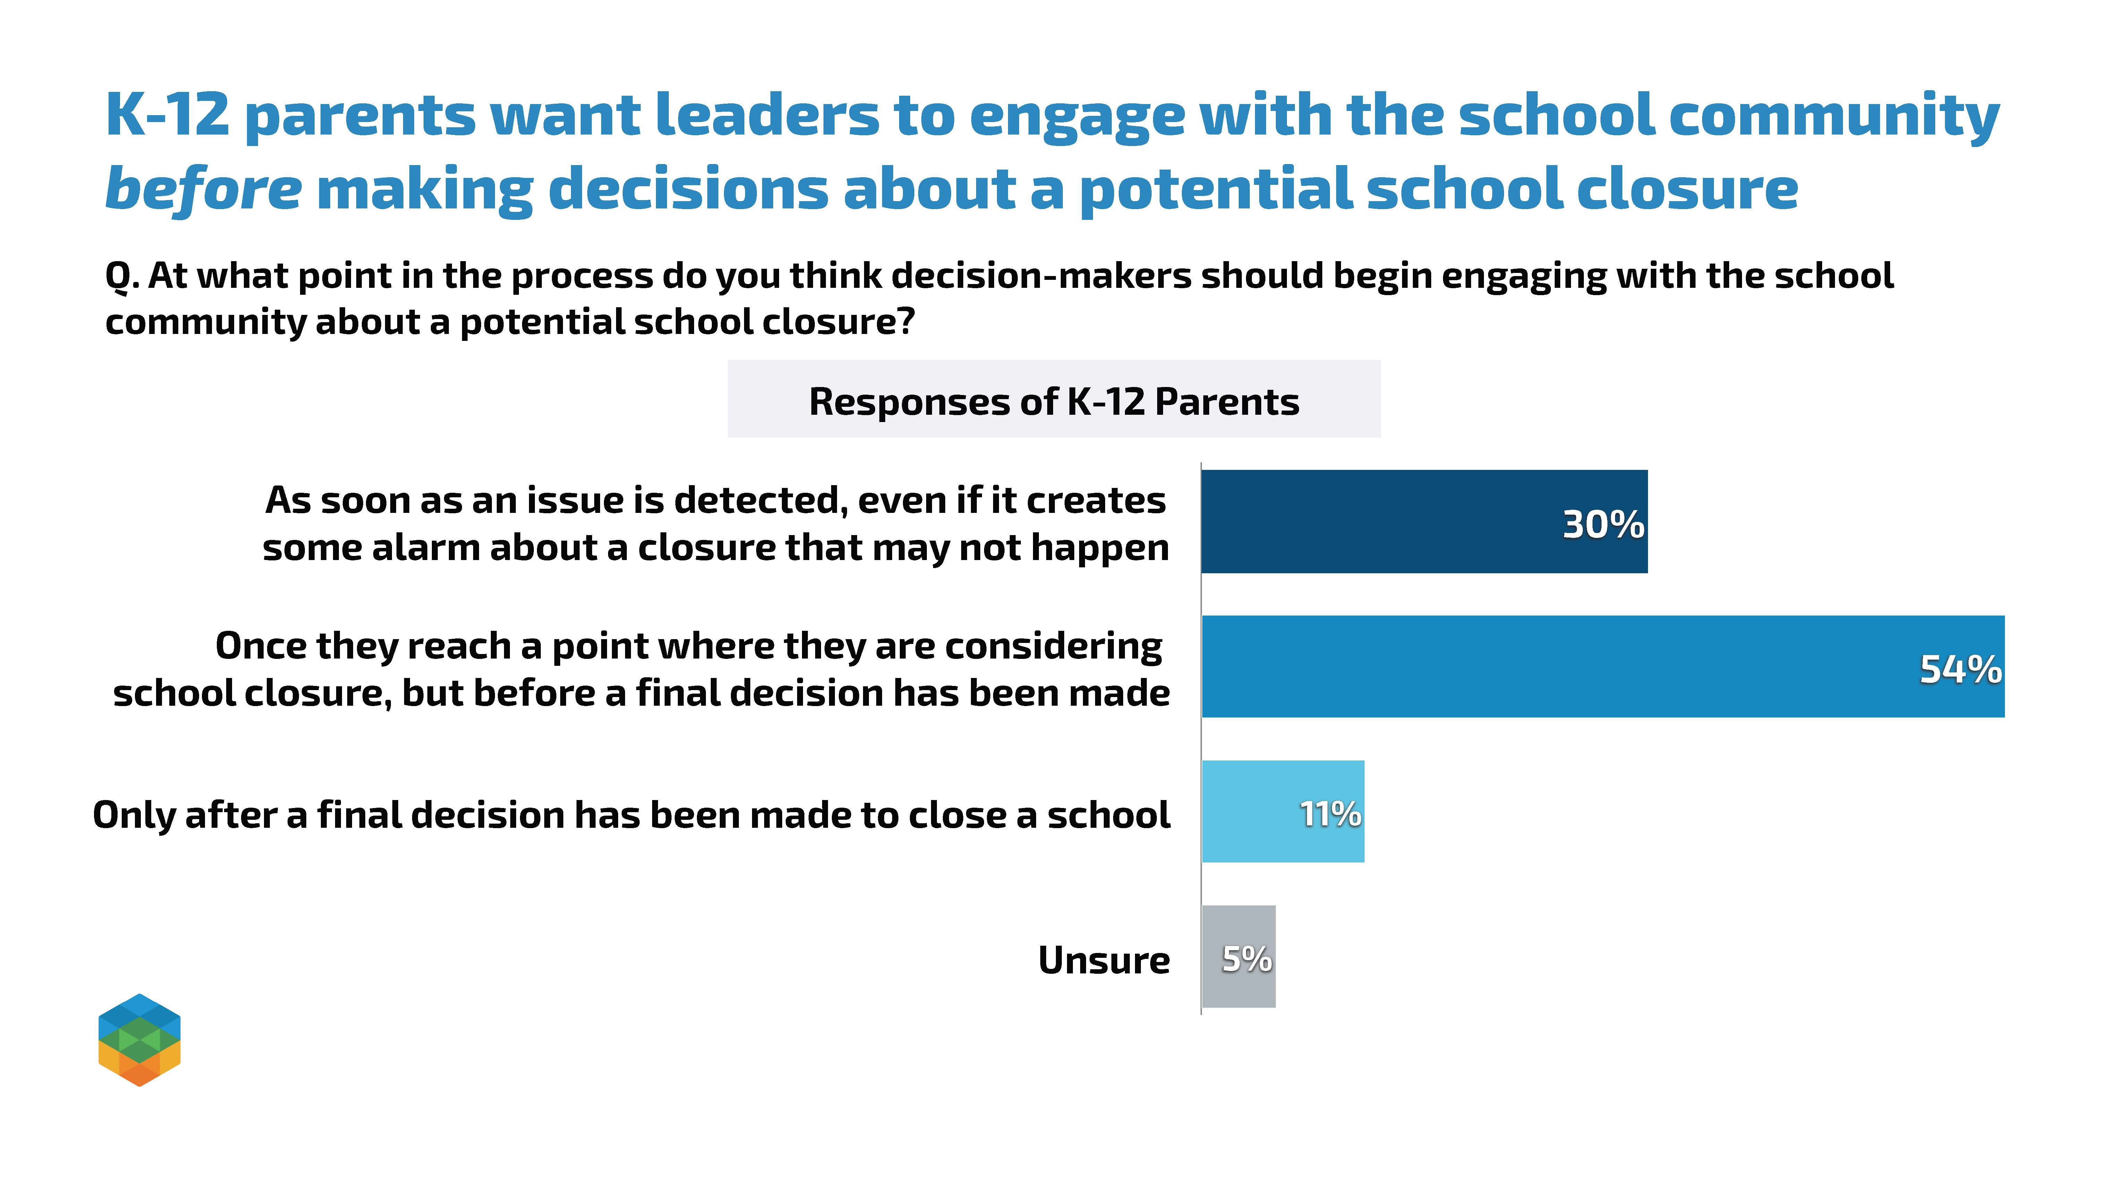

Slide 30
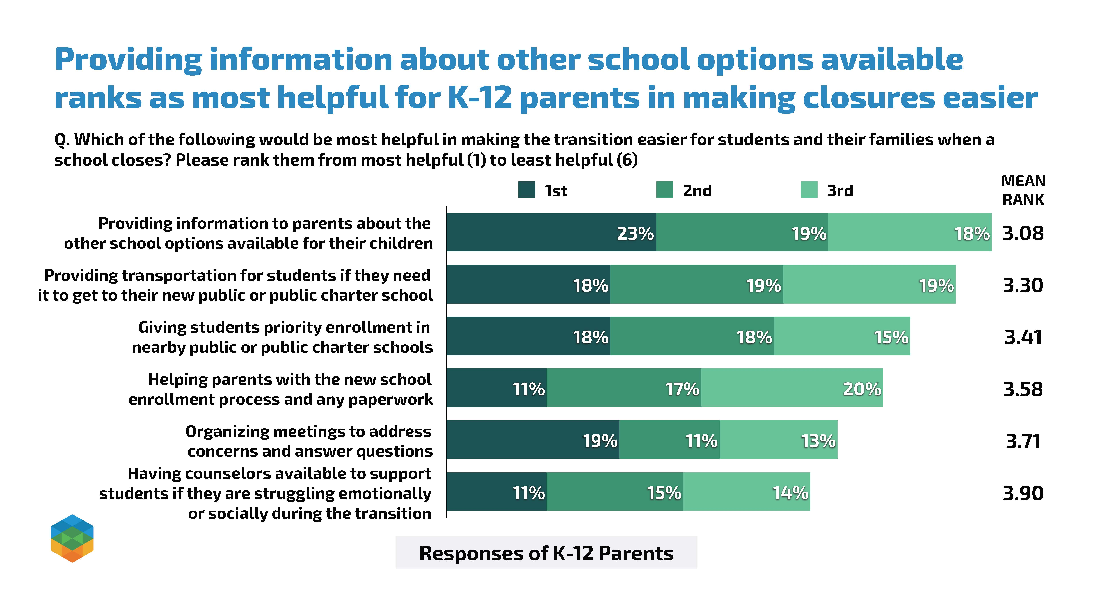

Slide 31
Recommendations

Slide 32
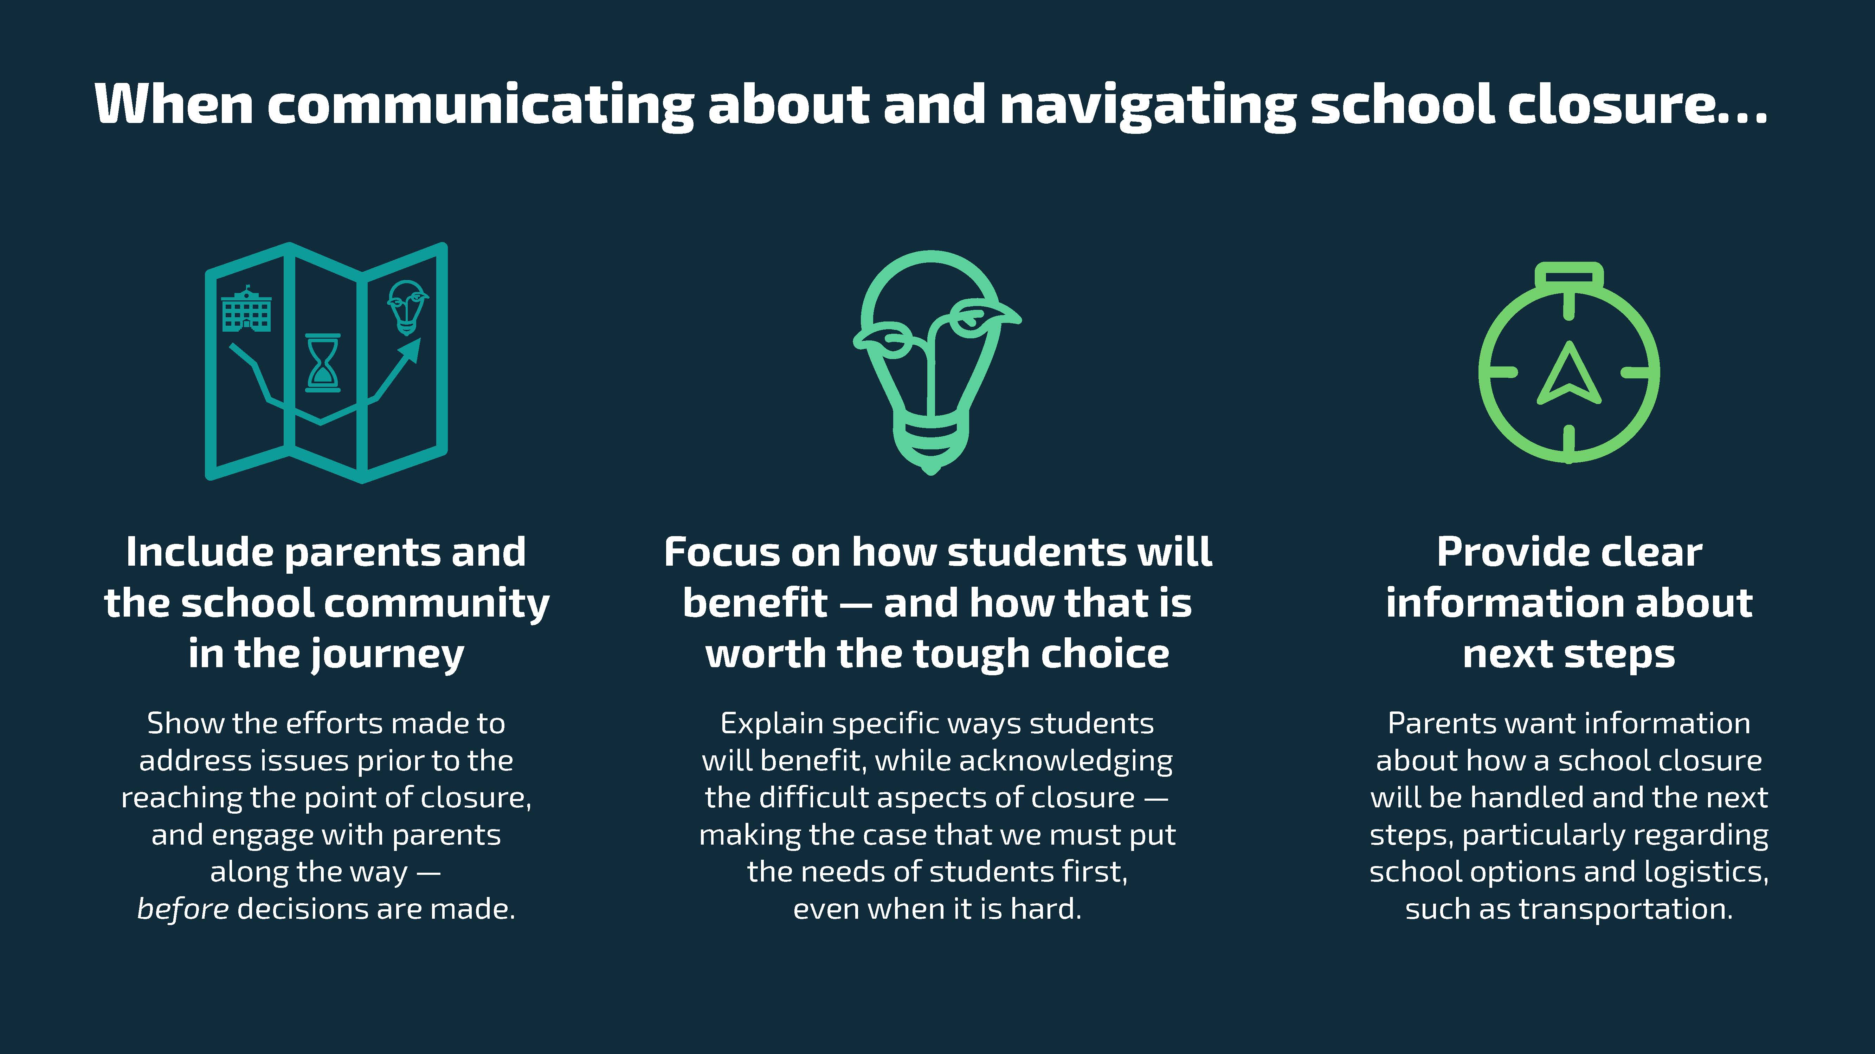

Slide 33
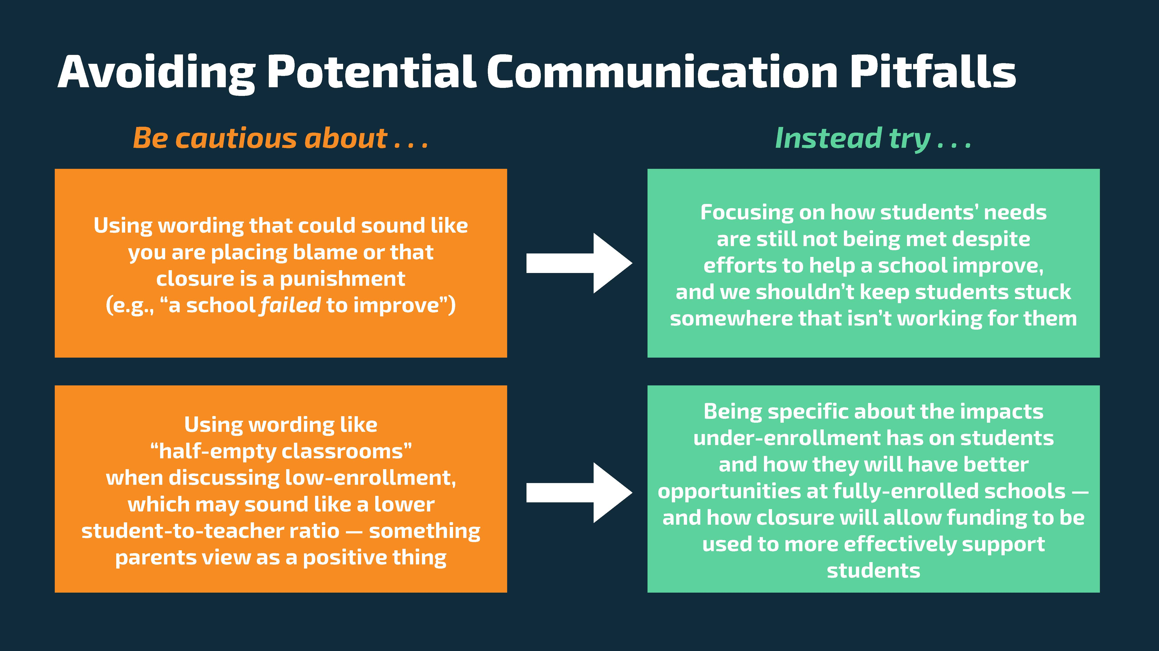

Slide 34
Other Notable Findings

Slide 35
Beyond Consolidation, Merger, and Closure Messaging
General views on school performance
Areas voters and parents prioritize for improvement
Factors parents consider in school evaluation
Benefits & Drawbacks of consolidation/mergers/closures
How parents prefer to be informed

Slide 36
Q&A

Slide 37


"The only podcast that tells the stories of charter school authorizing and the people that strive to ensure students and families have access to quality public schools."
Listen at: https://communityconversationswithnacsa.buzzsprout.com/
Notes:
We want to thank our members for supporting NACSA's mission and encourage those who aren't members to consider joining. You can learn more about member benefits, discounts, and perks by visiting our website

Slide 38
Thanks for joining us! www.qualitycharters.org
  Courtney Hughley, NACSA
  courtneyh@qualitycharters.org

